Slide 1
Digital Design &
Computer Architecture
Sarah Harris & David Harris
Chapter 4:
Hardware Description Languages

Slide 2
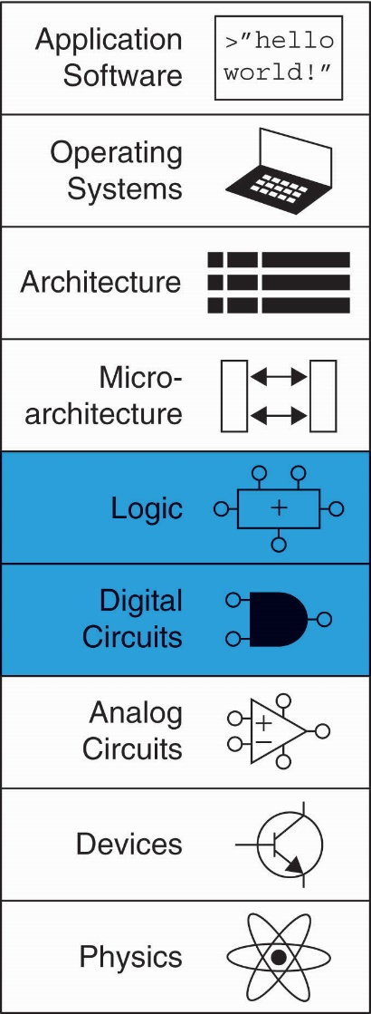
Chapter 4 :: Topics
Introduction
Combinational Logic
Delays
Sequential Logic
Combinational Logic w/ Always
Blocking & Nonblocking Assignments
Finite State Machines
Parameterized Modules
Testbenches

Slide 3
Chapter 4: Hardware Description Languages
Introduction

Slide 4
Introduction
Hardware description language (HDL):
Specifies logic function only
Computer-aided design (CAD) tool produces or synthesizes the optimized gates
Most commercial designs built using HDLs
Two leading HDLs:
SystemVerilog
Developed in 1984 by Gateway Design Automation
IEEE standard (1364) in 1995
Extended in 2005 (IEEE STD 1800-2009)
VHDL 2008
Developed in 1981 by the Department of Defense
IEEE standard (1076) in 1987
Updated in 2008 (IEEE STD 1076-2008)

Slide 5
HDL to Gates
Simulation
Inputs applied to circuit
Outputs checked for correctness
Millions of dollars saved by debugging in simulation instead of hardware
Synthesis
Transforms HDL code into a netlist describing the hardware (i.e., a list of gates and the wires connecting them)

Slide 6
HDL: Hardware Description Language
IMPORTANT:
When using an HDL, think of the hardware the HDL should produce, then write the appropriate idiom that implies that hardware.
Beware of treating HDL like software and coding without thinking of the hardware.

Slide 7
SystemVerilog Modules
SystemVerilog
Module
Two types of Modules:
Behavioral: describe what a module does
Structural: describe how it is built from simpler modules

Slide 8
Module Declaration
SystemVerilog:
module example(input logic a, b, c,
output logic y);
// module body goes here
endmodule
module/endmodule: required to begin/end module
example: name of the module
SystemVerilog
Module

Slide 9
Behavioral SystemVerilog
SystemVerilog:
module example(input logic a, b, c,
output logic y);
assign y = ~a & ~b & ~c | a & ~b & ~c | a & ~b & c;
endmodule
module/endmodule: required to begin/end module
example: name of the module
Operators:
~: NOT
&: AND
|: OR

Slide 10
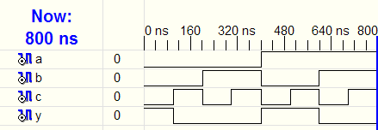
HDL Simulation
SystemVerilog:
module example(input logic a, b, c,
output logic y);
assign y = ~a & ~b & ~c | a & ~b & ~c | a & ~b & c;
endmodule

Slide 11
HDL Synthesis
SystemVerilog:
module example(input logic a, b, c,
output logic y);
assign y = ~a & ~b & ~c | a & ~b & ~c | a & ~b & c;
endmodule
Synthesis:

Slide 12
SystemVerilog Syntax
Case sensitive
Example: reset and Reset are not the same signal.
No names that start with numbers
Example: 2mux is an invalid name
Whitespace ignored
Comments:
// single line comment
/* multiline
comment */

Slide 13
Structural SystemVerilog
module and3(input logic a, b, c,
output logic y);
assign y = a & b & c;
endmodule
module inv(input logic a,
output logic y);
assign y = ~a;
endmodule
module nand3(input logic a, b, c
output logic y);
logic n1; // internal signal
and3 andgate(a, b, c, n1); // instance of and3
inv inverter(n1, y); // instance of inv
endmodule

Slide 14
Chapter 4: Hardware Description Languages
Combinational
Logic

Slide 15
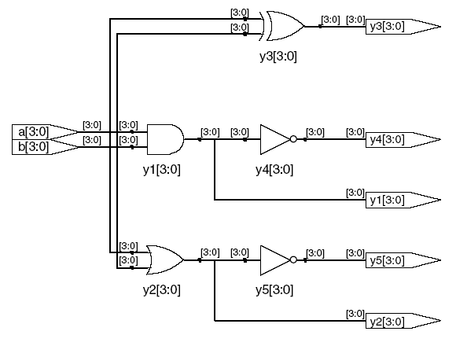
Bitwise Operators
SystemVerilog:
module gates(input logic [3:0] a, b,
output logic [3:0] y1, y2, y3, y4, y5);
/* Five different two-input logic
gates acting on 4 bit busses */
assign y1 = a & b; // AND
assign y2 = a | b; // OR
assign y3 = a ^ b; // XOR
assign y4 = ~(a & b); // NAND
assign y5 = ~(a | b); // NOR
endmodule
// single line comment
/*…*/ multiline comment
Synthesis:

Slide 16
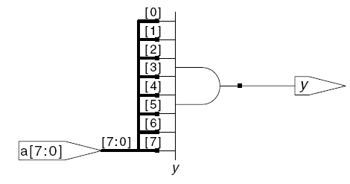
Reduction Operators
SystemVerilog:
module and8(input logic [7:0] a,
output logic y);
assign y = &a;
// &a is much easier to write than
// assign y = a[7] & a[6] & a[5] & a[4] &
// a[3] & a[2] & a[1] & a[0];
endmodule
Synthesis:

Slide 17
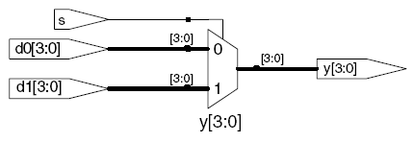
Conditional Assignment
SystemVerilog:
module mux2(input logic [3:0] d0, d1,
input logic s,
output logic [3:0] y);
assign y = s ? d1 : d0;
endmodule
? : is also called a ternary operator because it
operates on 3 inputs: s, d1, and d0.
Synthesis:

Slide 18
Internal Variables
SystemVerilog:
module fulladder(input logic a, b, cin,
output logic s, cout);
logic p, g; // internal nodes
assign p = a ^ b;
assign g = a & b;
assign s = p ^ cin;
assign cout = g | (p & cin);
endmodule
Synthesis:

Slide 19
Precedence
Highest
~ | NOT
*, /, % | mult, div, mod
+, - | add, sub
<<, >> | shift
<<<, >>> | arithmetic shift
<, <=, >, >= | comparison
==, != | equal, not equal
&, ~& | AND, NAND
^, ~^ | XOR, XNOR
|, ~| | OR, NOR
?: | ternary operator
Lowest

Slide 20
Numbers
Format: N'Bvalue
N = number of bits, B = base
N'B is optional but recommended (default is decimal)
Number | # Bits | Base | Decimal Equivalent | Stored
3'b101 | 3 | binary | 5 | 101
'b11 | unsized | binary | 3 | 00…0011
8'b11 | 8 | binary | 3 | 00000011
8'b1010_1011 | 8 | binary | 171 | 10101011
3'd6 | 3 | decimal | 6 | 110
6'o42 | 6 | octal | 34 | 100010
8'hAB | 8 | hexadecimal | 171 | 10101011
42 | Unsized | decimal | 42 | 00…0101010

Slide 21
Bit Manipulations: Example 1
SystemVerilog:
assign y = {a[2:1], {3{b[0]}}, a[0], 6'b100_010};
If y is a 12-bit signal, the above statement produces:
y = a[2] a[1] b[0] b[0] b[0] a[0] 1 0 0 0 1 0
Underscores (_) are used for formatting only to make it easier to read. SystemVerilog ignores them.

Slide 22
Bit Manipulations: Example 2
SystemVerilog:
module mux2_8(input logic [7:0] d0, d1,
input logic s,
output logic [7:0] y);
mux2 lsbmux(d0[3:0], d1[3:0], s, y[3:0]);
mux2 msbmux(d0[7:4], d1[7:4], s, y[7:4]);
endmodule
Synthesis:

Slide 23
Z: Floating Output
SystemVerilog:
module tristate(input logic [3:0] a,
input logic en,
output tri [3:0] y);
assign y = en ? a : 4'bz;
endmodule
Synthesis:

Slide 24
Chapter 4: Hardware Description Languages
Delays

Slide 25
Delays
SystemVerilog:
module example(input logic a, b, c,
output logic y);
logic ab, bb, cb, n1, n2, n3;
assign #1 {ab, bb, cb} = ~{a, b, c};
assign #2 n1 = ab & bb & cb;
assign #2 n2 = a & bb & cb;
assign #2 n3 = a & bb & c;
assign #4 y = n1 | n2 | n3;
endmodule
Delays are for simulation only! They do not determine the delay of your hardware.
Simulation

Slide 26
Delays
SystemVerilog:
Simulation
module example(input logic a, b, c,
output logic y);
logic ab, bb, cb, n1, n2, n3;
assign #1 {ab, bb, cb} = ~{a, b, c};
assign #2 n1 = ab & bb & cb;
assign #2 n2 = a & bb & cb;
assign #2 n3 = a & bb & c;
assign #4 y = n1 | n2 | n3;
endmodule

Slide 27
Delays
SystemVerilog:
Simulation
1
module example(input logic a, b, c,
output logic y);
logic ab, bb, cb, n1, n2, n3;
assign #1 {ab, bb, cb} = ~{a, b, c};
assign #2 n1 = ab & bb & cb;
assign #2 n2 = a & bb & cb;
assign #2 n3 = a & bb & c;
assign #4 y = n1 | n2 | n3;
endmodule

Slide 28
Delays
SystemVerilog:
Simulation
2
module example(input logic a, b, c,
output logic y);
logic ab, bb, cb, n1, n2, n3;
assign #1 {ab, bb, cb} = ~{a, b, c};
assign #2 n1 = ab & bb & cb;
assign #2 n2 = a & bb & cb;
assign #2 n3 = a & bb & c;
assign #4 y = n1 | n2 | n3;
endmodule

Slide 29
Delays
SystemVerilog:
Simulation
module example(input logic a, b, c,
output logic y);
logic ab, bb, cb, n1, n2, n3;
assign #1 {ab, bb, cb} = ~{a, b, c};
assign #2 n1 = ab & bb & cb;
assign #2 n2 = a & bb & cb;
assign #2 n3 = a & bb & c;
assign #4 y = n1 | n2 | n3;
endmodule
2

Slide 30
Delays
SystemVerilog:
Simulation
module example(input logic a, b, c,
output logic y);
logic ab, bb, cb, n1, n2, n3;
assign #1 {ab, bb, cb} = ~{a, b, c};
assign #2 n1 = ab & bb & cb;
assign #2 n2 = a & bb & cb;
assign #2 n3 = a & bb & c;
assign #4 y = n1 | n2 | n3;
endmodule
4

Slide 31
Chapter 4: Hardware Description Languages
Sequential Logic

Slide 32
Sequential Logic
SystemVerilog uses idioms to describe latches, flip-flops and FSMs
Other coding styles may simulate correctly but produce incorrect hardware

Slide 33
always Statement
General Structure:
always @(sensitivity list)
statement;
Whenever the event in sensitivity list occurs, statement is executed

Slide 34
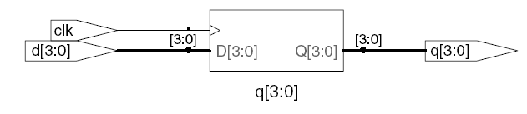
D Flip-Flop
module flop(input logic clk,
input logic [3:0] d,
output logic [3:0] q);
always_ff @(posedge clk)
q <= d; // pronounced “q gets d”
endmodule
Synthesis:

Slide 35
Resettable D Flip-Flop
module flopr(input logic clk,
input logic reset,
input logic [3:0] d,
output logic [3:0] q);
// synchronous reset
always_ff @(posedge clk)
if (reset) q <= 4'b0;
else q <= d;
endmodule
Synthesis:

Slide 36
Resettable D Flip-Flop
module flopr(input logic clk,
input logic reset,
input logic [3:0] d,
output logic [3:0] q);
// asynchronous reset
always_ff @(posedge clk, posedge reset)
if (reset) q <= 4'b0;
else q <= d;
endmodule
Synthesis:

Slide 37
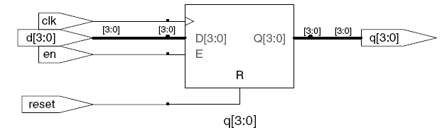
D Flip-Flop with Enable
module flopren(input logic clk,
input logic reset,
input logic en,
input logic [3:0] d,
output logic [3:0] q);
// enable and asynchronous reset
always_ff @(posedge clk, posedge reset)
if (reset) q <= 4'b0;
else if (en) q <= d;
endmodule
Synthesis:

Slide 38
Latch
module latch(input logic clk,
input logic [3:0] d,
output logic [3:0] q);
always_latch
if (clk) q <= d;
endmodule
Warning: We don’t use latches in this text. But you might write code that inadvertently implies a latch. Check synthesized hardware – if it has latches
in it that you didn’t intend to create, there’s an error.
Synthesis:

Slide 39
Review
General Structure:
always @(sensitivity list)
statement;
Flip-flop: always_ff
Latch: always_latch (don’t use)

Slide 40
Chapter 4: Hardware Description Languages
Combinational Logic using always

Slide 41
if/else and case/casez
Statements that must be inside always statements:
if / else
case, casez

Slide 42
Combinational Logic using always
// combinational logic using an always statement
module gates(input logic [3:0] a, b,
output logic [3:0] y1, y2, y3, y4, y5);
always_comb // need begin/end because there is
begin // more than one statement in always
y1 = a & b; // AND
y2 = a | b; // OR
y3 = a ^ b; // XOR
y4 = ~(a & b); // NAND
y5 = ~(a | b); // NOR
end
endmodule
This hardware could be described with assign statements using fewer lines of code, so it’s better to use assign statements in this case.

Slide 43
Combinational Logic using case
module sevenseg(input logic [3:0] data,
output logic [6:0] segments);
always_comb
case (data)
// abc_defg
0: segments = 7'b111_1110;
1: segments = 7'b011_0000;
2: segments = 7'b110_1101;
3: segments = 7'b111_1001;
4: segments = 7'b011_0011;
5: segments = 7'b101_1011;
6: segments = 7'b101_1111;
7: segments = 7'b111_0000;
8: segments = 7'b111_1111;
9: segments = 7'b111_0011;
default: segments = 7'b000_0000; // required
endcase
endmodule
Don’t forget!

Slide 44
Combinational Logic using case
case statement implies combinational logic only if all possible input combinations described
Remember to use default statement

Slide 45
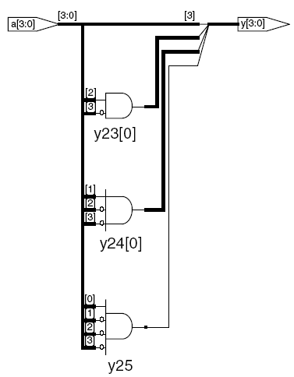
Combinational Logic using casez
module priority_casez(input logic [3:0] a,
output logic [3:0] y);
always_comb
casez(a)
4'b1???: y = 4'b1000; // ? = don’t care
4'b01??: y = 4'b0100;
4'b001?: y = 4'b0010;
4'b0001: y = 4'b0001;
default: y = 4'b0000;
endcase
endmodule
Synthesis:

Slide 46
Chapter 4: Hardware Description Languages
Blocking and Nonblocking Assignments

Slide 47
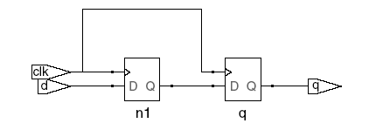

Blocking vs. Nonblocking Assignment
<= is nonblocking assignment
Occurs simultaneously with others
= is blocking assignment
Occurs in order it appears in file
// Good synchronizer using
// nonblocking assignments
module syncgood(input logic clk,
input logic d,
output logic q);
logic n1;
always_ff @(posedge clk)
begin
n1 <= d; // nonblocking
q <= n1; // nonblocking
end
endmodule
// Bad synchronizer using
// blocking assignments
module syncbad(input logic clk,
input logic d,
output logic q);
logic n1;
always_ff @(posedge clk)
begin
n1 = d; // blocking
q = n1; // blocking
end
endmodule

Slide 48
Rules for Signal Assignment
Synchronous sequential logic: use always_ff @(posedge clk)and nonblocking assignments (<=)
always_ff @(posedge clk)
q <= d; // nonblocking
Simple combinational logic: use continuous assignments (assign…)
assign y = a & b;
More complicated combinational logic: use always_comb and blocking assignments (=)
Assign a signal in only one always statement or continuous assignment statement.

Slide 49
Chapter 4: Hardware Description Languages
Finite State Machines

Slide 50
Finite State Machines
Three blocks:
next state logic
state register
output logic

Slide 51
FSM Example 1: Divide by 3
The double circle indicates the reset state

Slide 52
Divide by 3 FSM in SystemVerilog
module divideby3FSM(input logic clk,
input logic reset,
output logic q);
typedef enum logic [1:0] {S0, S1, S2} statetype;
statetype state, nextstate;
// state register
always_ff @(posedge clk, posedge reset)
if (reset) state <= S0;
else state <= nextstate;
// next state logic
always_comb
case (state)
S0: nextstate = S1;
S1: nextstate = S2;
S2: nextstate = S0;
default: nextstate = S0;
endcase
// output logic
assign q = (state == S0);
endmodule

Slide 53
FSM Example 2: Sequence Detector

Slide 54
Sequence Detector FSM: Moore
module seqDetectMoore(input logic clk, reset, a,
output logic smile);
typedef enum logic [1:0] {S0, S1, S2} statetype;
statetype state, nextstate;
// state register
always_ff @(posedge clk, posedge reset)
if (reset) state <= S0;
else state <= nextstate;
// next state logic
always_comb
case (state)
S0: if (a) nextstate = S0;
else nextstate = S1;
S1: if (a) nextstate = S2;
else nextstate = S1;
S2: if (a) nextstate = S0;
else nextstate = S1;
default: nextstate = S0;
endcase
// output logic
assign smile = (state == S2);
endmodule

Slide 55
FSM Example 3: Sequence Detector

Slide 56
Sequence Detector FSM: Mealy
module seqDetectMealy(input logic clk, reset, a,
output logic smile);
typedef enum logic {S0, S1} statetype;
statetype state, nextstate;
// state register
always_ff @(posedge clk, posedge reset)
if (reset) state <= S0;
else state <= nextstate;
// next state and output logic
always_comb begin
smile = 1'b0;
case (state)
S0: if (a) nextstate = S0;
else nextstate = S1;
S1: if (a) begin
nextstate = S0;
smile = 1'b1;
end
else nextstate = S1;
default: nextstate = S0;
endcase
end
endmodule

Slide 57
Chapter 4: Hardware Description Languages
Parameterized
Modules

Slide 58
Parameterized Module
2:1 mux:
module mux2
#(parameter width = 8) // name and default value
(input logic [width-1:0] d0, d1,
input logic s,
output logic [width-1:0] y);
assign y = s ? d1 : d0;
endmodule
Instance with 8-bit bus width (uses default):
mux2 myMux(d0, d1, s, out);
Instance with 12-bit bus width:
mux2 #(12) lowmux(d0, d1, s, out);

Slide 59
Chapter 4: Hardware Description Languages
Testbenches

Slide 60
Testbenches
HDL that tests another module: device under test (dut)
Not synthesizeable
Types:
Simple
Self-checking
Self-checking with testvectors

Slide 61
Testbenches
Write SystemVerilog code to implement the following function in hardware. Name the module sillyfunction.
y = bc + ab
module sillyfunction(input logic a, b, c,
output logic y);
assign y = ~b & ~c | a & ~b;
endmodule

Slide 62
Testbench 1: Simple Testbench
module testbench1();
logic a, b, c;
logic y;
// instantiate device under test
sillyfunction dut(a, b, c, y);
// apply inputs one at a time
initial begin
a = 0; b = 0; c = 0; #10;
c = 1; #10;
b = 1; c = 0; #10;
c = 1; #10;
a = 1; b = 0; c = 0; #10;
c = 1; #10;
b = 1; c = 0; #10;
c = 1; #10;
end
endmodule

Slide 63
Testbench 2: Self-Checking Testbench
module testbench2();
logic a, b, c;
logic y;
sillyfunction dut(a, b, c, y); // instantiate dut
initial begin // apply inputs, check results one at a time
a = 0; b = 0; c = 0; #10;
if (y !== 1) $display("000 failed.");
c = 1; #10;
if (y !== 0) $display("001 failed.");
b = 1; c = 0; #10;
if (y !== 0) $display("010 failed.");
c = 1; #10;
if (y !== 0) $display("011 failed.");
a = 1; b = 0; c = 0; #10;
if (y !== 1) $display("100 failed.");
c = 1; #10;
if (y !== 1) $display("101 failed.");
b = 1; c = 0; #10;
if (y !== 0) $display("110 failed.");
c = 1; #10;
if (y !== 0) $display("111 failed.");
end
endmodule

Slide 64
Testbench 3: Testbench w/ Testvectors
Testvector file: inputs and expected outputs
Testbench:
Generate clock for assigning inputs, reading outputs
Read testvectors file into array
Assign inputs, expected outputs
Compare outputs with expected outputs and report errors

Slide 65
Testbench 3: Testbench w/ Testvectors
Testbench clock:
Assign inputs (on rising edge).
Compare outputs with expected outputs (on falling edge).
Testbench clock also used as clock for synchronous sequential circuits

Slide 66
Testbench 3: Testvectors File
File: example.txt
contains vectors of abc_yexpected
//abc_yexpected
000_1
001_0
010_0
011_0
100_1
101_1
110_0
111_0

Slide 67
1. Generate Clock
module testbench3();
logic clk, reset;
logic a, b, c, yexpected;
logic y;
logic [31:0] vectornum, errors; // bookkeeping variables
logic [3:0] testvectors[10000:0]; // array of testvectors
// instantiate device under test
sillyfunction dut(a, b, c, y);
// generate clock
always // no sensitivity list, so it always executes
begin
clk = 1; #5; clk = 0; #5;
end

Slide 68
2. Read Testvectors into Array
// at start of test, load vectors and pulse reset
initial
begin
$readmemb("example.tv", testvectors);
vectornum = 0; errors = 0;
reset = 1; #22; reset = 0;
end
// Note: $readmemh reads testvector files written in
// hexadecimal

Slide 69
3. Assign Inputs and Expected Outputs
// apply test vectors on rising edge of clk
always @(posedge clk)
begin
#1; {a, b, c, yexpected} = testvectors[vectornum];
end

Slide 70
4. Compare with Expected Outputs
// check results on falling edge of clk
always @(negedge clk)
if (~reset) begin // skip during reset
if (y !== yexpected) begin
$display("Error: inputs = %b", {a, b, c});
$display(" outputs = %b (%b expected)",y,yexpected);
errors = errors + 1;
end
// Note: to print in hexadecimal, use %h. For example,
// $display(“Error: inputs = %h”, {a, b, c});
// increment array index and read next testvector
vectornum = vectornum + 1;
if (testvectors[vectornum] === 4'bx) begin
$display("%d tests completed with %d errors",
vectornum, errors);
$stop;
end
end
endmodule
// === and !== can compare values that are 1, 0, x, or z.
This bit width needs to be the same as vector size!

Slide 71
About these Notes
Digital Design and Computer Architecture Lecture Notes
© 2021 Sarah Harris and David Harris
These notes may be used and modified for educational and/or non-commercial purposes so long as the source is attributed.

